Slide 1




HR ANALYTICS

Slide 2


Agenda
Project Overview
Introduction
Dataset Overview
Data Merging
Final Metric KPIs
Dashboards
Insights
Key Takeaways
Recommendations
Conclusion
MS-Excel
Power BI
Tableau
SQL
List of TOOLS
2

Slide 3

Project Overview
Domain : HR Analytics
Project Name: Employee Retention
Dataset Name: HR_1 & HR_2
Dataset Type: Microsoft Excel
Dataset Size: 50k records each

Slide 4

INTRODUCTION
Project Summary:
The HR Analytics Project focuses on analyzing real employee data to understand workforce behavior and organizational trends. Its main purpose is to identify the factors affecting employee retention, satisfaction, and performance. By examining key HR metrics like attrition, demographics, job satisfaction, salary, promotions, and performance ratings, the project reveals important patterns in the workforce. It helps the organization understand who is leaving, why they leave, and which departments face higher attrition. The project also shows how salary, workload, and work-life balance influence employee decisions. Overall, it converts raw HR data into insights that support better decision-making and stronger retention strategies.
Objectives:
Understand Attrition Drivers
Analyze Workforce Demographics (age, gender, education, experience, and marital status distribution)
Evaluate Employee Satisfaction (job satisfaction, work environment, relationships, and work-life balance)
Assess Impact of Salary & Promotions (Check how pay, promotions, and workload influence employee retention)
Support HR Decision-Making (Provide insights to improve hiring, training, and engagement strategies)

Slide 5
DATASET OVERVIEWS
Attrition : Yes→ Attrition Status: 1 , If “No”, then 0.
Business Travel : Travel Rarely, Non-Travel & Travel Frequently
Daily Rate: Represents the amount an employee earns per day.
Distance From Home : in km
Education: 1- High School, 2-College, 3- Under Graduate, 4- Post Graduate, 5-PhD
Education Field: Human Resources, Life Sciences, Marketing, Medical, Technical Degree, Other
Environment Satisfaction: 1 – Poor, 2- Average, 3-Good, 4- Excellent
Gender – Female/ Male
Hourly Rate- Employee charged per hour. 1- Inactive/Passive, 2- Poorly Focused, 3- Averagely active, 4- Active
Job Level: Designation in the company.1 - Entry-Level / Associate / Intern , 2- Intermediate Level, 3- Senior Level, 4-Managerial Level, 5- Executive/Director Level
Job Role: Developer, Health care Rep, Human Resources, Lab Technician, Manager, Manufacturing Director, Research Director, Research Scientist, Sales Executive, Sales Rep.
Job Satisfaction: 1- Poor , 2-Average, 3-Good, 4- Excellent
Marital Status : Single, Married, Divorced
Monthly Income (HR-2): Monthly salary of an employee
Monthly income Status (HR-2):
Low Income | 0-12750
Medium Income | 12751-25500
High income | 25501-38250
Very High Income | 38251-50999

Slide 6
DATASET OVERVIEW
Num Companies Worked (HR-2): Number of companies previously worked
Over Time (HR-2): Yes- Overtime working, No- No Overtimes
Percent Salary Hike (HR-2): Hikes from 1- 49%
Performance Rating (HR-2): 1- Low, 2-Good, 3- Excellent, 4-Outstanding
Relationship Satisfaction (HR-2): 1- Highly Dissatisfied, 2-Dissatisfied, 3- Satisfied, 4- Highly Satisfied
Standard Hours (HR-2): Fixed to 80 hours
Stock Option Level (HR-2) Stocks assigned to employees : 1- Low Level, 2- Medium Level, 3- High Level, 4- Very High level
Total Working Years (HR-2): Employee working years ranging from 2 to 40 years overall
Training Times Last Year (HR-2): 1 to 6 courses/workshops/ trainings conducted on employees
Work Life Balance (HR-2)/ WORK_LIFE_STATUS (HR-2): 1- Bad, 2-Average, 3-Good, 4-Best
Years At Company (HR-2): Employee working years at this company ranging from 2 to 40 years
Years In Current Role (HR-2): Employee working years at this company in the same role ranging from 2 to 40 years
Years Since Last Promotion (HR-2):No of years since the Employee got promoted ranging from 1 to 40 years
Years With Curr Manager (HR-2): No of years with the same manager
Recent Promotion Status (HR-2): Recently Promoted where “Years Since Last Promotion” = 1 & No Recent Promotions where “Years Since Last Promotion” > 1
Promotion Status over years (HR-2): 0-10 Promoted → “Years Since Last Promotion” is 1-10 , 11-20 Promoted, 21-30 Promoted, 31-40 Promoted
Age bins (HR-2): Young- 1-15 yrs, Middle Age 15-30 yrs, Old Age 31-45 yrs & Very old 45-60 yrs
Job Satisfaction Rating (HR-2): 1- Poor , 2- Average, 3- Good , 4- Excellent

Slide 7

DATA MERGING
DATA MERGING
1. Integration and Consolidation:
Merging (using a Join) allows permanent combining the necessary columns of Employee Number from HR 1 and Employee ID from HR 2 into a single, comprehensive table.
This created a unified view where all required data fields for KPI calculation (like salary, job role, and attrition status) exist in one row per employee.
2. Performance Optimization:
For these specific datasets and the high-level KPI calculations required (like Attrition Rate by Promotion Status), creating a single joined table often leads to faster query execution and better performance than running complex calculations across two separate, related tables.
3. Simple KPI Creation: A single merged table simplifies the calculation of KPIs like percentages and ratios because the numerator and denominator fields are immediately accessible within the same data source, avoiding the need for complex level-of-detail (LOD) expressions or relationship-based logic.
FILES FOR MERGING
Goal: To combine data from two separate sources (hr1 and hr2) into a single, cohesive table.
Benefit: This allows for a richer dataset where all relevant employee information (like Age, Department, Monthly Income, and Over Time) can be analyzed together.
Table 1 (Top): The primary table, named hr1.
Contains general employee and job-related attributes (e.g., Age, Department, Distance From Home).
Table 2 (Bottom): The secondary table, named hr2.
Contains compensation and history attributes (e.g., Monthly Income, Num Companies Worked, Over Time).

Slide 8
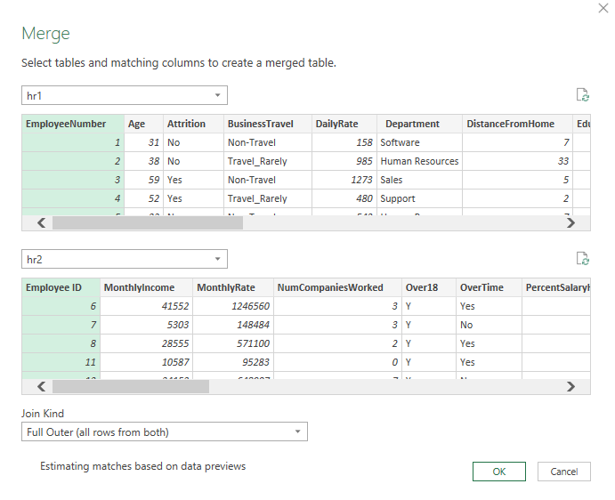
DATA MERGING
THE CRUCIAL 'JOIN KEY’
Definition: To accurately link the rows, a common column (a key) must be selected in both tables.
In this Example: The join key is implicitly the employee identifier. You would usually select these two columns to establish the match
  In hr1, it is the Employee Number column (seen in the data preview).
  In hr2, it is the Employee ID column (seen in the data preview).
UNDERSTANDING THE 'JOIN KIND'
Selection: Full Outer join
Explanation: A Full Outer Join ensures that:
  All rows from the first table (hr1) are included.
  All rows from the second table (hr2) are included.
  Rows that match on the join key are combined.

Slide 9
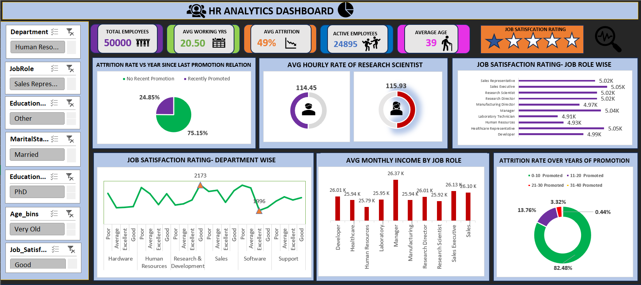
EXCEL DASHBOARD

Slide 10
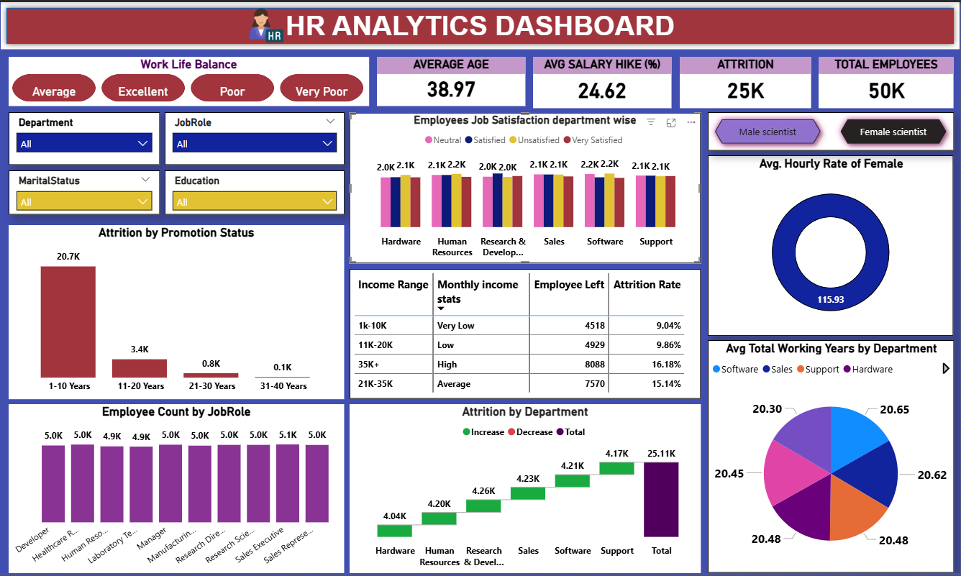
POWER BI DASHBOARD

Slide 11
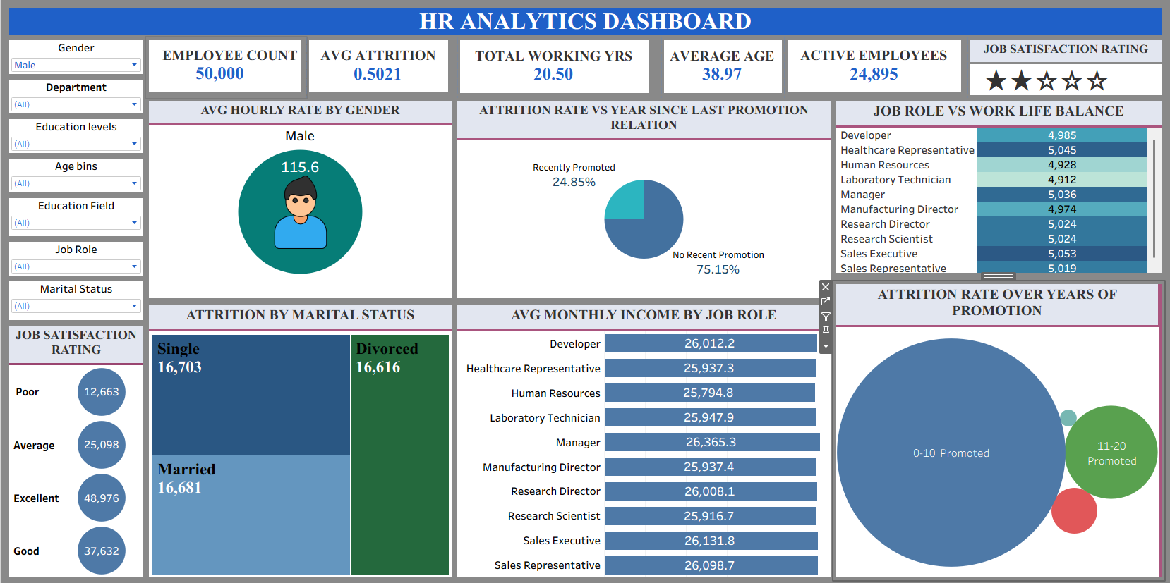
TABLEAU DASHBOARD

Slide 12
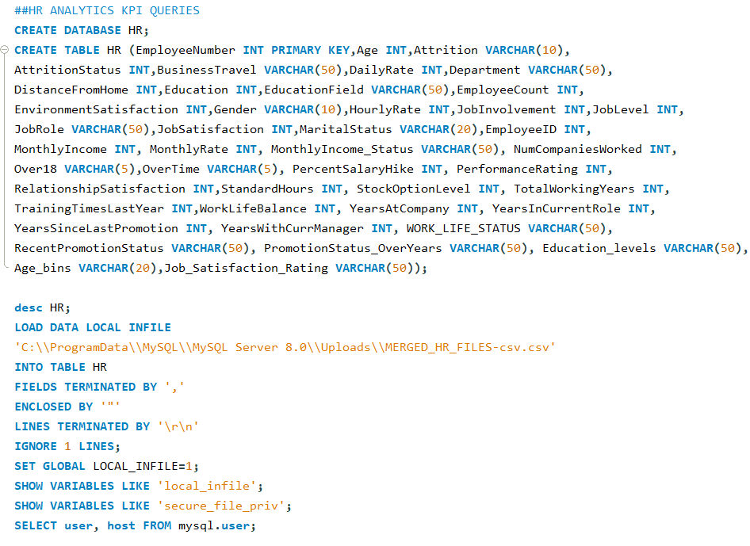
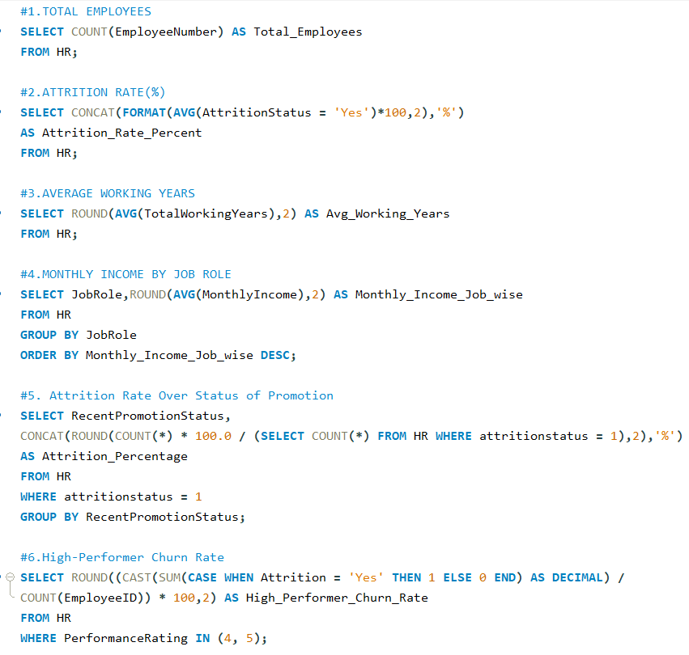
SQL QUERIES FOR KPIS
13

Slide 13
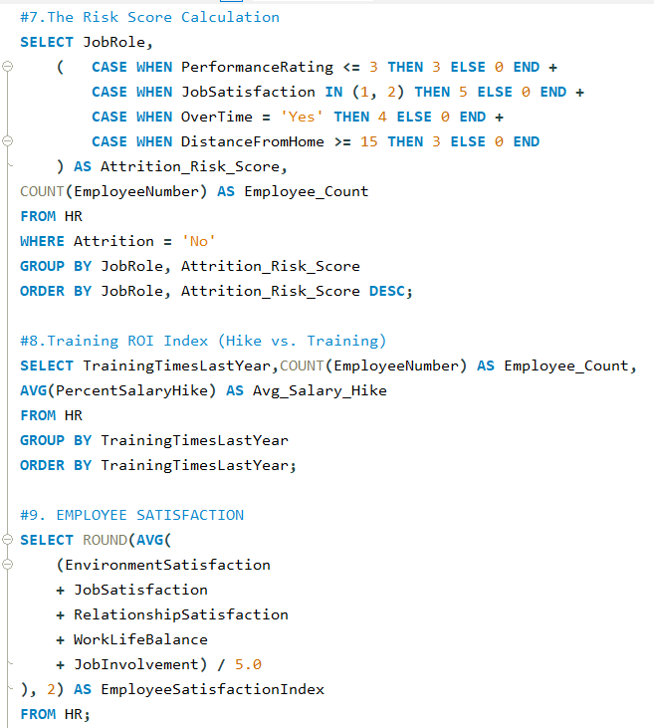
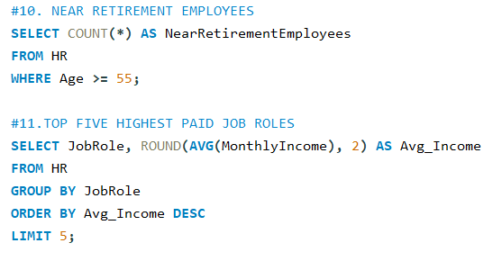
SQL QUERIES FOR KPIS

Slide 14

INSIGHTS
1. Promotion Has the Strongest Impact on Retention
75–82% of attrition comes from employees who were not recently promoted
Employees who received promotions show significantly lower exit rates
INSIGHT: Lack of career growth is the primary driver of employee turnover
2.Early & Mid-Career Employees Are at Highest Risk
Highest attrition is observed in 0–10 years since last promotion.
Attrition drastically reduces after 20+ years of tenure
INSIGHT: Employee retention efforts must focus on early-tenure and mid-level employees Work-Life Balance Directly Influences Retention
3. Work-Life Balance Directly Influences Retention
Employees reporting Poor or Very Poor work-life balance have: Lower job satisfaction, Higher attrition.
INSIGHT: Even competitive salaries fail to retain employees with poor work-life balance
4. Gender Is Not a Retention Risk Factor
Average hourly wage for male and female employees is almost identical
No noticeable gender-based attrition imbalance
INSIGHT: Retention issues are organizational, not gender-driven

Slide 15
5. Department-Wise Retention Risk
Highest attrition: Software, Sales, Support
Lowest attrition :Hardware, Human Resources
INSIGHT: High-pressure and customer-facing roles face the highest burnout-driven exits
6. Low Salary Bands Experience Higher Attrition
Employees in Very-Low and Low-income ranges show the highest exit rates
High-income groups have significantly better retention
INSIGHT: Compensation plays a critical role in retaining operational and support staff
7. Job Satisfaction Is a Retention Indicator
Employees with Poor or Average satisfaction ratings contribute disproportionately to attrition
Roles with linked satisfaction & promotion show better retention
INSIGHT: Job satisfaction can be used as an early-warning signal for attrition
---
### 8. **Balanced Hiring but Imbalanced Retention**
* Employee count across job roles is evenly distributed
* Attrition is uneven, concentrated in **lower-paid & high-pressure roles**
✅ **Insight:** Retention problem is **role-specific**, not hiring-volume related
---
## 📌 Overall Retention Story (1-Line Summary for Interview)
> *Employee attrition is primarily driven by lack of promotions, poor work-life balance, and low compensation in high-pressure roles, especially among early-career employees.*
---
## 🎯 Business Recommendations (Retention-Focused)
1. Implement **regular promotion & career path planning**
2. Improve **work-life balance policies** in Sales, Software, Support
3. Revise **pay structure for low-income job roles**
4. Track **job satisfaction scores** as an attrition predictor
5. Launch **early-career retention programs**
---
If you want, I can also:
✅ Give **5 one-line insights for PPT**
✅ Convert this into **Tableau/Power BI dashboard narration**
✅ Prepare **interview Q&A based on retention**
Just say 👍

Slide 16
KEY TAKEAWAYS
Lack of recent promotions leads to high attrition
Career stagnation is a primary reason for exits
Early-career employees show the highest attrition
Attrition decreases as tenure increases
Poor work–life balance increases attrition
Burnout impacts retention more than salary
Software, Support, and Sales face higher attrition
HR and Hardware show better retention
Lower salary bands have higher exits
Low job satisfaction strongly predicts attrition
No significant gender-based attrition difference

Slide 17
RECOMMENDATIONS
Implement regular promotion & career path planning
Improve work-life balance policies in Sales, Software, Support
Revise pay structure for low-income job roles
Track job satisfaction scores as an attrition predictor
Launch early-career retention programs

Slide 18
Thank you…

